Slide 1
Isaiah 40:25-31 (NIV)
25"To whom will you compare me? Or who is my equal?" says the Holy One. 26Lift your eyes and look to the heavens: Who created all these? He who brings out the starry host one by one, and calls them each by name. Because of his great power and mighty strength, not one of them is missing. 27Why do you say, O Jacob, and complain, O Israel, "My way is hidden from the Lord ; my cause is disregarded by my God"?

Slide 2
Isaiah 40:25-31 (NIV)
28Do you not know? Have you not heard? The Lord is the everlasting God, the Creator of the ends of the earth. He will not grow tired or weary, and his understanding no one can fathom. 29He gives strength to the weary and increases the power of the weak. 30Even youths grow tired and weary, and young men stumble and fall; 31but those who hope in the Lord will renew their strength. They will soar on wings like eagles; they will run and not grow weary, they will walk and not be faint.

Slide 3
Looking Back – Living Forward
Lessons for today, learned from Old Testament Prophets

Slide 4
Looking Back – Living Forward
Lessons for today, learned from Old Testament Prophets
August 7th – Philip Adams
Isaiah 40: 21-31

Slide 5
Why Study the Prophets?
Isaiah
Part of God’s Word
¹⁶ All Scripture is God-breathed and is useful for teaching, rebuking, correcting and training in righteousness, (2 Timothy 3:16)

Slide 6
Why Study the Prophets?
Isaiah
Key part of old testament prophecy
Bible prophecy comprises passages of the Bible that reflect communication from God to humans through prophets. Christians consider biblical prophets to have received revelations from God.
Most of what they said were to the people in front of them – forthtelling (telling people like it is).
Only a small amount was foretelling (about the future).

Slide 7
Why Study the Prophets?
Isaiah
They link the Old Testament with the New Testament by revealing who Jesus would be
Isaiah sounds more like a New Testament writer:
(53:1-3) Jesus’ perfect character.
(53:4-6) Jesus brought peace with God.
(53:7-9) Jesus paid for the transgression of the people.
(53:10-12) Jesus died for the effects of sin.

Slide 8
Why Study the Major Prophets?
Isaiah
They give us a bigger view of God
Not a Old Testament God
Not a New Testament God
But a God who is keenly interested in us as individuals and part of societies.

Slide 9
Comfort (40:21-31)
Isaiah
Words of Comfort for God’s People (chapters 40-66)

Slide 10
Comfort (40:21-31)
Isaiah
Chapters 1-39 are written to the Northern Kingdom of Israel, warning of its fall to Assyria, which happened during Isaiah’s lifetime (Chapter 39).
Chapters 40-66 are written to the Southern Kingdom of Judah, to help them through their Babylonian exile (100 years after Isaiah dies).
Isaiah assures his people of God’s continued presence with them and His plan to eventually return them to their homes.

Slide 11
Comfort (40:21-31)
Isaiah
Focus today is on chapter 40, verses 21-31
Its single theme is seen in Verse 1,
“Comfort for God’s people” in time of turmoil.
It applies to all people that seek God’s comfort. It’s for the people of Jerusalem 3000 years ago, and it’s for us today.

Slide 12
Comfort (40:21-31)
Isaiah
Comfort from God comes:
(1) When we understand He is Great
(2) When we understand He is Interested.
(3) When we trust Him.

Slide 13
Comfort (40:21-31)
Isaiah
1. He is Great – He is bigger than my problems (21-26)
In verses 21-26, Isaiah records God’s greatness.
God is so far above the globe of planet earth that we all look like grasshoppers to him. He created the heavens, including every star in the night sky.
Earthly rulers are like seeds that are swept away by the wind. They serve at God’s pleasure, whether they know it or not. They are here today, gone tomorrow. God says, “Who are you going to compare me with?

Slide 15
Comfort (40:21-31)
Isaiah
1. He is Great – He is bigger than my problems (21-26)
If God is great, that means he has the capacity to deal with my problems.
Your problem may SEEM big, but God is bigger. When we’re in difficulty, that problem, that challenge seems overwhelming. But nothing is overwhelming to God.

Slide 16
Comfort (40:21-31)
Isaiah
2. God is interested – He knows my concerns (27-31)
God’s people are headed toward exile. For seventy years, they will wonder whether God has abandoned them.
Yet, consider Isaiah’s challenge to them in verse 27: “Why do you complain, Jacob? Why do you say, Israel, ‘My way is hidden from the Lord; my cause is disregarded by my God’?”

Slide 18
Comfort (40:21-31)
Isaiah
2. God is interested – He knows my concerns (27-31)
Isaiah reminds us, “Yes, God cares.” God is interested. Verse 29: “He gives strength to the weary and increases the power of the weak.”
When you think you’re at the end of your rope, God helps you to keep going. To put one foot in front of the other. To get out of bed in the morning. To keep going.

Slide 19
Comfort (40:21-31)
Isaiah
3. Trusting Him (30-31)
“Even youths grow tired and weary, and young men stumble and fall; but those who hope in the Lord will renew their strength. They will soar on wings like eagles; they will run and not grow weary, they will walk and not be faint.”
“Hope” means certain expectation. It’s not like you hope you’re going to win the lottery. It’s more like you KNOW God will come through one way or another.

Slide 20
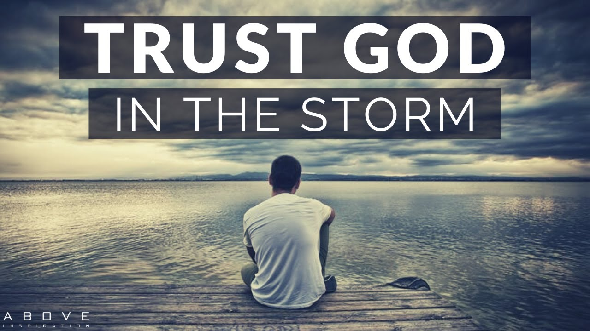

Slide 21
Comfort (40:21-31)
Isaiah
3. Trusting Him (30-31)
Knowing God is Great and Cares is necessary, but true comfort comes through trusting Him in everything.
Earlier, Isaiah expressed it like this (chapter 26:3-4).
You will keep in perfect peace him whose mind is steadfast, because he trusts in you. Trust in the Lord for ever, for the Lord, the Lord, is the Rock eternal.

Slide 22
Comfort (40:21-31)
Isaiah
So do not fear, for I am with you.
Do not be dismayed for I am your God.
I will strengthen you and help you.
I will uphold you with my righteous right hand
Isaiah 41:10

